Slide 1

Process Safety
Business Case Template
A Resource for AGA Members
AGA Process Safety Sub-committee
December, 2016
CCPS, The Business Case for Process Safety
Copyright © 2006 AIChE and used with permission

Slide 2
Notice
In issuing and making this publication available, AGA is not undertaking to render professional or other services for or on behalf of any person or entity. Nor is AGA undertaking to perform any duty owed by any person or entity to someone else. Anyone using this document should rely on his or her own independent judgment or, as appropriate, seek the advice of a competent professional in determining the exercise of reasonable care in any given circumstances. The statements in this publication are for general information and represent an unaudited compilation of statistical information that could contain coding or processing errors. AGA makes no warranties, express or implied, nor representations about the accuracy of the information in the publication or its appropriateness for any given purpose or situation.
This publication shall not be construed as including, advice, guidance, or recommendations to take, or not to take, any actions or decisions in relation to any matter. Should you take any such action or decision; you do so at your own risk. Information on the topics covered by this publication may be available from other sources, which the user may wish to consult for additional views or information not covered by this publication.
Copyright © 2016 American Gas Association. All rights reserved. www.aga.org

Slide 3
AGA Safety & Occupational Health Committee Process Safety Management Sub-committee Initiatives
Process Safety Business Case Template
  This slide deck will help organizations interested in starting and promoting the adoption of Process Safety develop a business case
  The following slides outline how Process Safety can enhance an organization by:
    Displaying the company’s high level of corporate and social responsibility
    Giving the company the freedom to manage its business
    Helping the company manage risk and prevent major losses
    Creating sustained value for the company and its shareholders
For Reference only: Remove this slide when customizing deck

Slide 4
The Business Case for Process Safety
DRAFT TEMPLATE – INTENDED FOR COMPANY MODIFICATION AS NEEDED FOR INTERNAL PRESENTATION PURPOSES
Process Safety Management
Notes:
The Business Case for Process Safety
The Center for Chemical Process Safety (CCPS), a not-for-profit organization associated with the American Institute for Chemical Engineers, counts as its members more than 70 of the world’s leading manufacturers of chemicals, petroleum products, pharmaceuticals, and other related materials, as well as insurance companies and others that serve these industries.
At the urging of the CCPS Advisory Board, an executive panel consisting of more than 20 senior industry executives, CCPS undertook this landmark study to identify the business case for companies to implement a strong Process Safety Management system.
CCPS was assisted in this study by four Chief Executive Officers, the senior executive members of its Advisory Board, representatives from its member companies, and other industrial stakeholders.
The study identified four distinct business reasons that cause a company to benefit from a strong Process Safety Program
CCPS thanks you for sharing the “Business Case for Process Safety” with your company. If you would like assistance with this presentation, more information about CCPS, or general information about Process Safety, please contact CCPS at 212-591-7319 or ccps@aiche.org

Slide 5
DRAFT TEMPLATE – INTENDED FOR COMPANY MODIFICATION AS NEEDED FOR INTERNAL PRESENTATION PURPOSES
What is Process Safety Management?
Process Safety Management (PSM) is a management system approach focused on preventing incidents. The focus on process safety originated in complex chemical operations, but applies to all asset intensive operations.
Process safety can be incorporated into an existing integrated management system, or can be a stand-alone system.
Process Safety focuses on:
  Technology
  Facilities
  Personnel

Slide 6
DRAFT TEMPLATE – INTENDED FOR COMPANY MODIFICATION AS NEEDED FOR INTERNAL PRESENTATION PURPOSES
Process Safety Compared to Personal Safety
Process safety is the prevention and mitigation of unintentional releases of potentially dangerous materials or energy through the use of robust processes and equipment reliability.
Process Safety is about:
Identifying and understanding potential hazards
Evaluating consequences, safeguards, and risks
Adding layers of protection (safeguards) to prevent and/or mitigate incidents
Protecting employees, the public, the environment and assets through these safeguards
Process Safety is not about:
Slips, trips and falls, or what is commonly referred to as “personal safety”

Slide 7
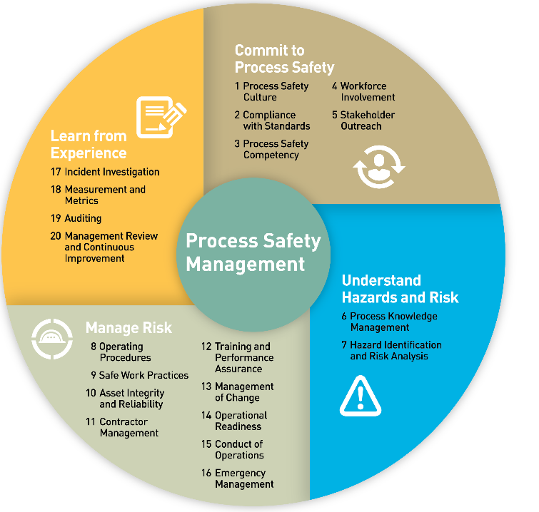
DRAFT TEMPLATE – INTENDED FOR COMPANY MODIFICATION AS NEEDED FOR INTERNAL PRESENTATION PURPOSES
Risk-Based Process Safety
Many of the elements in PSM are similar to other management systems
The value of Process Safety is related to hazard and risk identification and management of risks
Process Safety brings specific value with respect to:
  Operational Readiness
  Process and Hazard awareness
  Quantitative risk analysis
PG&E representation of the 20 elements of Risk Based Process Safety from CCPS
“Guidelines for Risk-Based Process Safety “, 2007, AIChE, NY
Notes:
There are various safety management systems available.
RBPS is the most comprehensive and rigorous
Has 20 elements

Slide 8
Process Safety Management
DRAFT TEMPLATE – INTENDED FOR COMPANY MODIFICATION AS NEEDED FOR INTERNAL PRESENTATION PURPOSES
Implementing Process Safety Methodology results in several key benefits, both quantitative and qualitative:
Risk Reduction
Sustained Value
Corporate Responsibility
Enhanced Safety & Compliance
“We have seen process safety benefit our business in ways we had not anticipated. We need to share this message with others.”
Arnold Allemang
Vice President, Global Manufacturing
The Dow Chemical Company

Slide 9
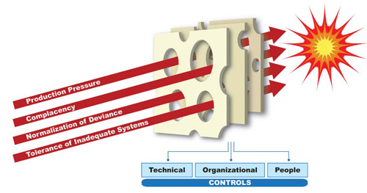
DRAFT TEMPLATE – INTENDED FOR COMPANY MODIFICATION AS NEEDED FOR INTERNAL PRESENTATION PURPOSES
Risk Reduction
Risk Reduction
  Process safety ensures the right controls are in place to prevent both personal and process safety events
  Robust risk management processes help ensure the organization is aware of top risks and appropriate mitigations have been applied
A robust process safety program may help the company:
  Save lives and reduce injuries
  Protect the public and the environment
  Reduce property damage costs
  Reduce business interruptions
  Protect market share
  Reduce litigation costs
  Reduce regulatory penalties from accidents
  Reduce regulatory attention
Source: National Energy Board (Canada) Statement on Safety Culture

Slide 10
DRAFT TEMPLATE – INTENDED FOR COMPANY MODIFICATION AS NEEDED FOR INTERNAL PRESENTATION PURPOSES
Risk Reduction
Benefits to the company
Significant reductions in injury rates*
  One company reduced injuries and fatalities resulting from major incidents by 50%
    Saving over $5 million/year in avoided losses
    Additional savings of $3 million/year in worker’s comp costs
Incidents cause operational interruptions
  Loss of production or force majeure can result in millions per day of losses
Incidents divert management’s attention from long-term business planning
* Based on CCPS chemical industry study
CCPS, The Business Case for Process Safety
Copyright © 2006 AIChE and used with permission

Slide 11
DRAFT TEMPLATE – INTENDED FOR COMPANY MODIFICATION AS NEEDED FOR INTERNAL PRESENTATION PURPOSES
Sustained Value
Sustained Value
  Process safety helps boost productivity through clarity of accountabilities, mitigation of hazards, and enhanced understanding of operations
  It helps produce high quality products, on time, and at lower cost
  It contributes to shareholder value through incident avoidance and operational efficiencies
Companies surveyed reported significant direct cost benefits of up to*:
  5% increases in productivity
  3% reduction in production costs
  5% reduction in maintenance costs
  1% reduction in capital budget
  20% reduction in insurance costs
* Based on CCPS chemical industry study
CCPS, The Business Case for Process Safety
Copyright © 2006 AIChE and used with permission

Slide 12
DRAFT TEMPLATE – INTENDED FOR COMPANY MODIFICATION AS NEEDED FOR INTERNAL PRESENTATION PURPOSES
Sustained Value
Process Safety helps increase productivity:
  Increased process and equipment reliability from mechanical integrity programs
  User-friendly, accurate operating procedures
  Improved team effectiveness through employee training
  Employee ownership of the systems
  Enhanced troubleshooting capabilities
  Extended intervals between major turnarounds
  Decreased turnaround time for major turnarounds and minor repairs
Production costs may be reduced through:
  Improvement in yields
  Lower costs for material rework (quality)
  Lower costs for waste stream disposal
  Prevention of hazards and operability issues before they occur
  More efficient staffing requiring less supervision
  Engaged employees participating in continuous improvement

Slide 13
DRAFT TEMPLATE – INTENDED FOR COMPANY MODIFICATION AS NEEDED FOR INTERNAL PRESENTATION PURPOSES
Sustained Value
Maintenance costs are reduced through:
  Effective equipment maintenance procedures
  Contractor safety programs
  Repairing or replacing critical equipment before it fails
  Avoiding unplanned shutdowns
  Lower maintenance turnaround costs
  Thorough periodic inspection
Capital budgets may be reduced through:
  Inherently safer process designs that begin in the conceptual phase
  Process hazard analyses for new projects and facilities
Insurance costs may be reduced through:
  Effective emergency planning and response
  Reporting and investigation of “near misses” to identify potential problems early
  Thorough incident reporting and investigation programs to prevent incidents from being repeated
  Lower casualty insurance premiums

Slide 14
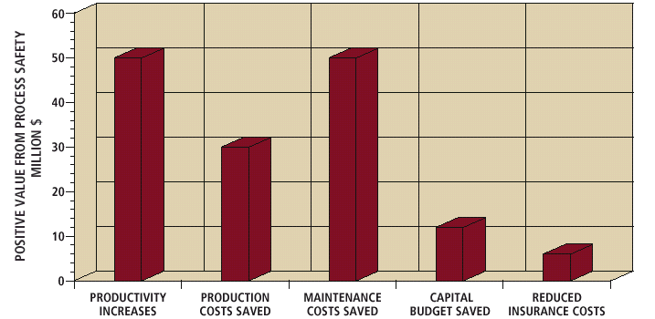
Sustained Value Data
* Based on CCPS chemical industry study
CCPS, The Business Case for Process Safety
Copyright © 2006 AIChE and used with permission
*Source 2001 CCPS Workshop

Slide 15
DRAFT TEMPLATE – INTENDED FOR COMPANY MODIFICATION AS NEEDED FOR INTERNAL PRESENTATION PURPOSES
Corporate Responsibility
Corporate Responsibility
  An effective process safety program displays sustained corporate responsibility
  It helps a company:
    Fulfill its obligation to protect employees and the community
    Enhance customer and supplier relationships
    Comply with regulations
    Conform to industry standards worldwide
Process Safety:
  Protects reputation and shareholder value
  Creates lower risk perception by investors
  Increases value of corporate image and brand
  Reduces concerns within the local community
  Engages employees - morale, loyalty, retention
  Helps assure insurance coverage at attractive rates
  Enhances lenders’ confidence
  Helps regulators understand the facility

Slide 16
Enhanced Safety & Compliance
Enhanced Safety & Compliance
  A company’s freedom to operate can be severely compromised due to an accident
    regulatory scrutiny
    legal complications
    intervention by directors when key stakeholders sense increased risk
    community discontent
  Process Safety is how accidents may be avoided
Process Safety:
  Demonstrates the Company’s ability to comply with all legal & regulatory requirements
  Strengthens and maintains good relationships with the local community
  Helps investors feel confident in the company’s ability to grow and earn profits
  Helps the company attract and retain high performance staff
  Helps the company obtain approval for expansion permits or new facilities more quickly
  Strengthens and maintains good relationships with regulators

Slide 17
DRAFT TEMPLATE – INTENDED FOR COMPANY MODIFICATION AS NEEDED FOR INTERNAL PRESENTATION PURPOSES
Business Case Summary
A robust process safety program enhances business four ways…
    Displays company’s high level of corporate and social responsibility
    Gives company the freedom to manage business
    Helps company manage risk and prevent major losses
    Creates sustained value for company and its shareholders

Slide 18
The Path Forward
REALIZE THE BENEFITS - Seven key steps
  Adopt a company philosophy of process safety
  Assign personnel who will be accountable
  Learn more about process safety
  Take advantage of the strong synergy process safety has with other business drivers
  Set achievable process safety goals
  Track performance
  Revisit process safety program
Notes:
Realize the benefits to achieving business excellence through process safety management
Personnel at plant and corporate levels.
Include accountability for operating unit executives
Continual learning. The more you learn about process safety, the better your results in all four benefit areas. You can learn from courses, books, and by networking with peers in other companies
Link your management systems based on the rigor of process safety management
For example, goals could be around:
implementation or integration of systems
reduction of incidents, leaks, etc.
reduction of off-site consequences
reduction of on or off-site risk
Use measurements to drive performance and communicate goals
On a period basis (for example, every three years), revisit your process safety program and revalidate process safety studies to maintain improvements and to progress further

Slide 19
DRAFT TEMPLATE – INTENDED FOR COMPANY MODIFICATION AS NEEDED FOR INTERNAL PRESENTATION PURPOSES
AGA Support
Contact AGA to find out about:
  Peer input to help build or upgrade process safety program
  Participation in projects that expand our industry’s capabilities in Process Safety

