Slide 1
Potential Supply of Natural Gas in the United States Report of the Potential Gas Committee
Press Conference | Washington, DC | September 14, 2023
Notes:
Hello. My name is Steve Sonnenberg. I am a Professor at Colorado School of Mines. I am also the Director of Potential Gas Agency. Today I will present to you the key results from the latest Report of the Potential Gas Committee on the Potential Supply of Natural Gas in the U.S.

Slide 2
Executive Summary
Potential Gas Committee (PGC):
Group of ~80 volunteer geoscientists and engineers.
Biennial assessments of technically recoverable U.S. natural gas endowment since 1964.
Assessment as of year-end 2022 (mean values):
3,353 Tcf of total U.S. technically recoverable gas resources:
15.4 Tcf or 0.5% decrease over the previous year-end 2020 assessment.
Shale gas resources account for ~61% of total gas resources.
Total U.S. future gas supply (reserves+resources) stands at record 3,978 Tcf.
www.potentialgas.org
Notes:
Here are our key messages. I would like you to know that Potential Gas Committee is a non-profit organization of about 80 volunteer geoscientists and engineers. The Committee produces assessments of technically recoverable natural gases in the U.S. The first such report was published in 1964. We publish a new report every 2 years.
This year we produced a new Report with assessments as of year-end 2022. Here are our main results. The total U.S. technically recoverable gas resources now stand at 3,352 Tcf. This is the mean value. This is 15.5 Tcf or 0.5% less than in the previous assessment done 2 years ago. We assess different types of reservoirs. Among them, shale reservoirs are very important as gas resources in these reservoirs account for 62% of total gas resources. When we combine resources assessed by the PGC with the reserves assessed by Energy Information Agency (EIA), we gat the total future supply of natural gas in the U.S., which now stands at 3,523 Tcf.
Let’s now discuss PGC and the assessment in more details.

Slide 3
Organization
Potential Gas Committee (PGC)
~80 volunteers
Kristin M. Carter
President/General Chairperson
Douglas G. Patchen
Chairman of the Board
- Recruits personnel and supervises work
- Develops assessment policy and procedures
- Directs and manages studies of gas resources
- Prepares reports on natural gas resources
Potential Gas Agency (PGA)
Colorado School of Mines
Supported by industry
Dr. Stephen A. Sonnenberg
Interim Director
Dr. Eric Roberts
New Director
Approves criteria and methods
Ensures maintenance of standards and objectivity
Reviews and evaluates reports
Publishes final assessments of gas resources
www.potentialgas.org
Notes:
Here is how we are organized to produce the assessment. The Potential Gas Committee or PGC is a non-profit organization of about 80 volunteers. These people are engineers and geoscientists who are very experienced in resource assessments and we are very grateful for the time and expertise that they provide.
The Committee is led by Kris Carter, who is our President and General Chairperson and the Board is chaired by Doug Patchen. Both of them are present today and will be happy to answer your questions later. The role of PGC is to recruit volunteers, develop assessment procedures, do the assessments and prepare the report. Now, the Potential Gas Agency or PGA at Colorado School of Mines was created in 1965 to help PGC with the assessments. I am the fifth Director of the Agency and I started in this role last year. The main goal of the Agency is to provide technical guidance and assurance to the Committee, and review and publish the report.

Slide 4
PGC assesses future supply of natural gas
Estimated by EIA
Assessed by PGC
Total Gas
Recoverable Gas
Unrecoverable Gas
Discovered
Undiscovered
Confirmed
Unconfirmed
Cumulative Production
Proved Reserves
Probable Resources
Possible Resources
Speculative Resources
Field extensions / New Pools
New Fields
New Plays / Basins
Future Supply of Natural Gas
www.potentialgas.org
Notes:
We assess the future supply of natural gas. Let’s clarify some terms that you will see today. There is total gas, but only a portion of it is technically recoverable. Some of that technically recoverable gas is discovered, but some of it is not. Some gas accumulations are discovered and confirmed by appraisal. Some of the confirmed gas is already produced, so it goes into this bucket of cumulative production. Some of the confirmed gas is not produced yet, but it is economically recoverable and it is just waiting to be produced. This gas sits in the bucket of Proved Reserves. If the gas is not fully appraised, for example if it is located in field extensions or in the new pools of the discovered field, then this is probable resource. Among undiscovered gas, we have possible resources, which we think may exist in the new fields in the proven basins and plays. And we have Speculative resources, which we think may exist in the new plays and new basins. As we move from left side of this diagram to the right side, we have decreasing certainty and availability of geological and engineering data. At PGC we assess the Probable, Possible and Speculative resources. Then we use EIA estimate of Proved Reserves to calculate the total Future Supply of Natural Gas.

Slide 5
7 PGC work areas and 90 geologic provinces
Settings:
Onshore
Offshore
Depth intervals:
Shallow (0-15,000 ft.)
Deep (15,000-30,000 ft.)
Reservoir types:
Traditional:
Conventional and tight
Shale gas
Coalbed gas (CBM)
www.potentialgas.org
Notes:
For our assessment, we split the U.S. into 7 work areas and 90 geological provinces. On this map you can see these provinces outlined with the thin red boundaries and labeled with P and numbers, for example P-120 for the Appalachian basin. The provinces are grouped into 7 areas, specifically Atlantic, North Central, Gulf Coast, Mid-Continent, Rocky Mountain, Pacific and Alaska. We make the assessments for both onshore and offshore, for shallow and deep reservoirs. We assess Traditional reservoirs, including conventional, tight and shale reservoirs and also coalbed gas or CBM.

Slide 6
PGC resource assessment methodology
Province-level assessments:
Publicly-available data.
Individual expert judgement by practicing geoscientists and engineers.
Group discussions and peer-reviews.
Minimum – Most Likely – Maximum resource values for each province.
Area-level assessments:
Statistical aggregation of province-level assessments to calculate Mean resources values.
National-level assessment:
Statistical aggregation of area-level assessments to calculate mean Grand Total resources for the U.S.
Mean values for different types of reservoirs and different resource categories.
Addition of EIA’s latest published proved reserves (year-end 2019) to calculate future gas supply.
www.potentialgas.org
Notes:
Let’s talk about our methodology. We start at the level of the geological provinces. As you remember from the previous slide there are 90 of them. We rely on publically-available data. Initial assessment is produced by our volunteer geoscientists and engineers. Then we have peer-reviews and group discussions to QC and assure the numbers. As a result, we get Minimum, Most Likely and Maximum resource values for each province. Then we aggregate these province-level values to the level of Area. We use statistical approach, run Monte-Carlo simulation and calculate the full probabilistic distribution of the values, including, most importantly, the Mean values, which we use for reporting. Then we do the next level of statistical aggregation and calculate resources at the national level. We calculate the mean Grand Total value. We also calculate mean values for different types of reservoirs and for different resource categories. We then add the most recent EIA published proved reserves to calculate the future gas supply.

Slide 7
Classification of Natural Gas Resource Adopted by the Potential Gas Committee
Notes:
Classification of natural gas resource as adopted by the Potential Gas Committee.

Slide 8
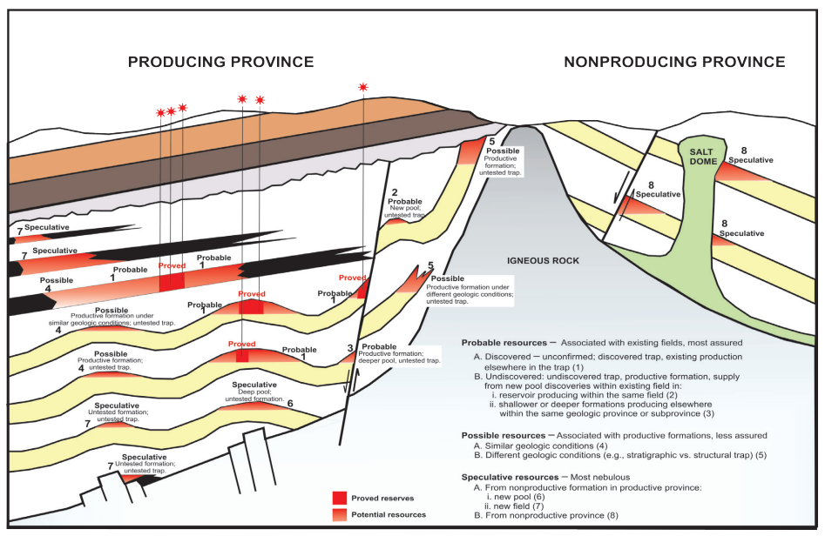
Categories and Types of Occurrence of Gas Resources
Notes:
Hypothetical cross section illustrating categories and types of occurrence of potential gas resources.

Slide 9
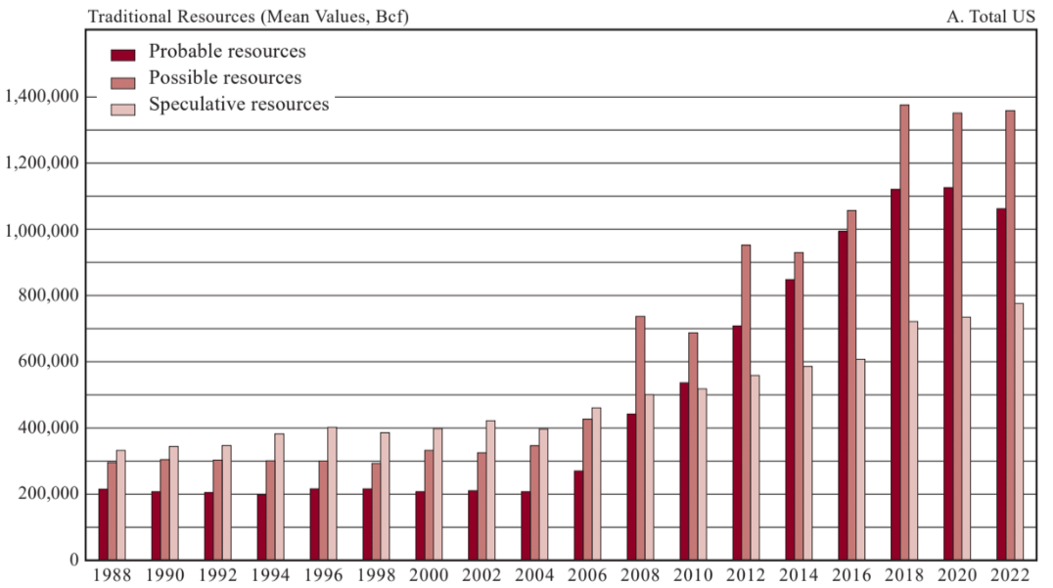
Traditional Resources (Mean Values, Bcf) (Total United States)
Probable: Associated with existing fields, most assured
Possible: Associated with productive formations, less assured
Speculative: most nebulous
Notes:
Potential Gas Committee’s historical assessments of Traditional natural gas resources, 1988 through 2022 by category (mean values, probable, possible, speculative), total United States

Slide 10
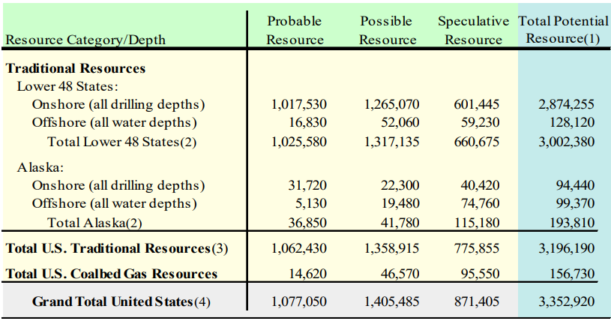
PGC assessment of Potential Natural Gas Resources in the United States (2022) (aggregate mean values, bcf)

Slide 11
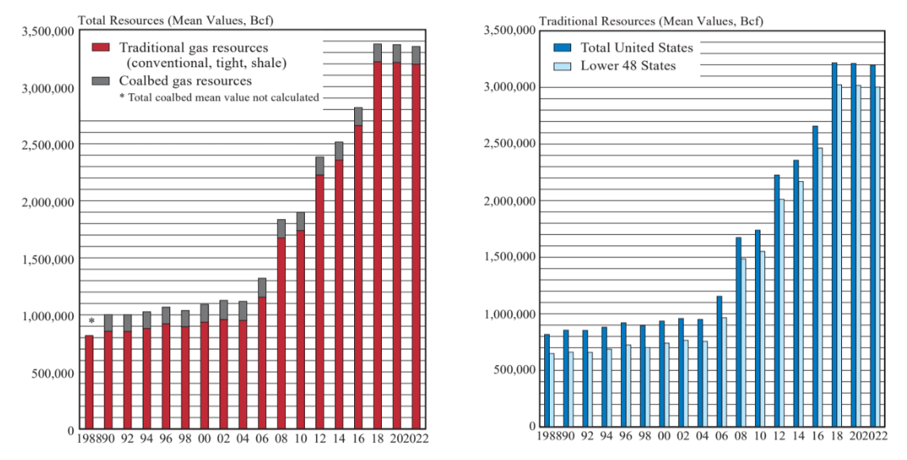
PGC historical assessment of total recoverable natural gas resources, US
Notes:
Total recoverable natural gas resources for US, traditional and coalbed gas, 1988-2022 (mean values bcf).

Slide 12
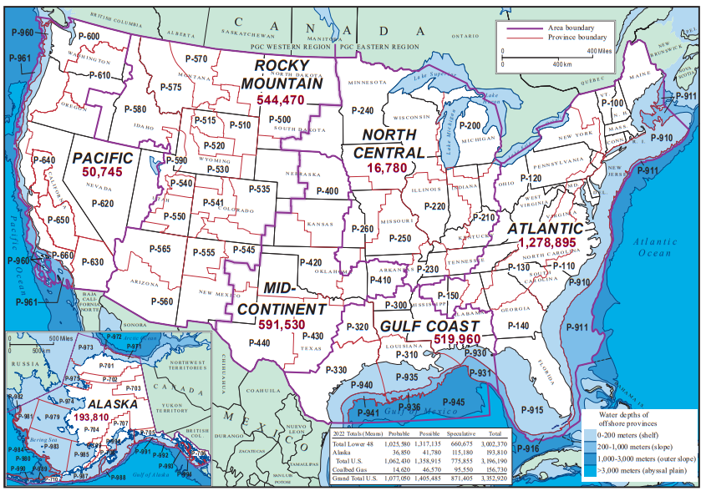
Gas Resource Assessment for Areas (2022) for Total Traditional Natural Gas (No CBM)
Atlantic (40%)
1,278.8 Tcf
Mid-Continent (18.5%)
591.5 Tcf
Rocky Mountain (17%)
544.4 Tcf
Gulf Coast (16%)
519.9 Tcf
Alaska (6%)
193.8 Tcf
Pacific (1.6%)
50.7 Tcf
North Central (<1%)
16.7 Tcf
Grand Total: 3,196 Tcf
Notes:
Potential Gas Committee Work Areas and geologic provinces, showing PGC’s year-end 2022 assessments of total Traditional gas
resources by area (mean values, billion cubic feet) with a summary of national Probable, Possible and Speculative totals and grand totals.

Slide 13
Areas ranked based on Total Gas Resources (includes Traditional Gas, no CBM)
PGC Assessment Area | Mean Technically Recoverable Volumes (trillion cubic feet or Tcf, rounded) | Proportion (%, rounded)
Atlantic | 1278.8 | 40
Mid-Continent | 591.5 | 18.5
Rocky Mountain | 544.4 | 17
Gulf Coast (incl. Gulf of Mexico) | 519.9 | 16
Alaska | 193.8 | 6
Pacific | 50.7 | 1.6
North Central | 16.7 | <1
www.potentialgas.org
Notes:
In this table we rank our assessment areas according to their mean technically recoverable gas volumes. Atlantic area is #1 with about 39% of total U.S. gas. Mid-Continent is about 18%, followed by Rocky Mountain at 17% and Gulf Coast at about 16%. The other 3 areas together have only about 10% of U.S. gas resources.

Slide 14
Year-end 2022 assessment results
 | Mean Technically Recoverable Volumes (trillion cubic feet or Tcf) (rounded)
Traditional gas resources (conventional, tight and shale reservoirs) | 3,196
Coalbed gas resources | 157
Total gas resources | 3,353
Proved gas reserves (EIA, year-end 2021) | 625
Future gas supply in the U.S. | 3,978
www.potentialgas.org
Notes:
And here are the results. We assessed traditional gas resources at about 3,196 tcf of mean technically recoverable resources. In addition, there is about 157 tcf of coalbed gas resources. The sum of these two values is the total gas resources. We then add proved gas reserves estimated by EIA and get future gas supply of about 3,978 tcf.

Slide 15
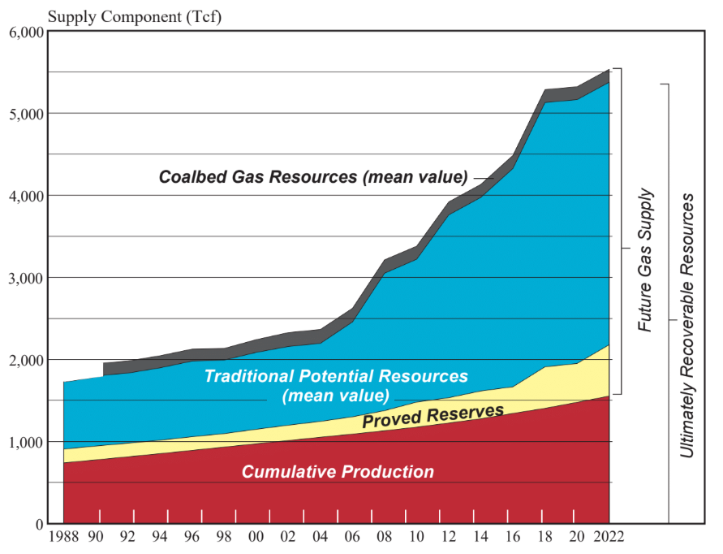
Future Supply and Ultimate Recoverable Resources of Natural Gas in U.S. (Tcf)
2022 numbers:
Cumulative Production
1,554 TCF
Proved Reserves
625 TCF
Potential Resources
Traditional
3,196 TCF
CBM
157 TCF
Notes:
Potential Gas Committee’s historical determinations of future supply and ultimately recoverable resources of natural gas in the United States, 1988 through 2022 (trillion cubic feet). Proved reserves and cumulative production from EIA.

Slide 16
Summary of PGC year-end 2020 assessment
3,353 Tcf of total U.S. gas resources (Traditional Gas and Coalbed Gas, mean value).
15 Tcf or 0.5% decrease from the previous year-end 2020 assessment.
Atlantic Area dominates with 40% of total U.S. gas resources.
Shale gas accounts for ~61% of total U.S. gas resources.
Total U.S. future gas supply (reserves+resources) stands at 3,978 Tcf.
www.potentialgas.org
Notes:
In summary, we assess that there are 3,352 Tcf of total gas resources in the U.S. Atlantic area has the lion share of gas resources, about 40% of U.S. total resources. Shale plays contribute very large resources, about 60% of total. When we add reserves and resources together, we have future gas supply, which now stands at record 3,978 Tcf. This is small increase over the previous assessment.

Slide 17
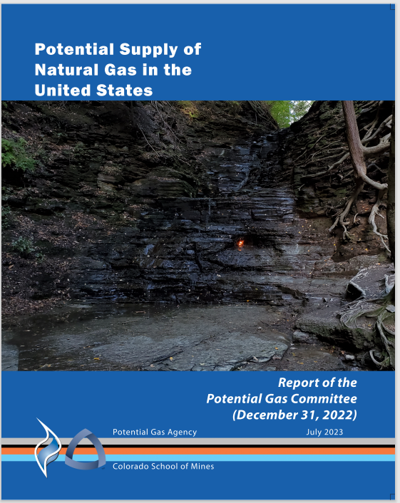
Contact PGA to obtain PDF of the Report
Dr. Eric Roberts
Potential Gas Agency
Colorado School of Mines
1516 Illinois Street
Golden, CO 80401
Email: eric.roberts@mines.edu
Office Phone: 303-273-3887
Mobile Phone: 303-946-1680
www.potentialgas.org
Notes:
The report itself has about 109 pages of valuable information. People who want to know more about our latest gas assessment, can obtain this report by contacting me at Potential Gas Agency. Thank you very much for your attention and I will be happy to take questions.

