Slide 1



Jan 1, 2026
New Mutual Aid RFA Form (Training)

Slide 2
Agenda
Why the Change?
Timeline of new Mutual Aid Agreement and New RFA Form
Process to use New RFA Form –Requesting and Responding
RFA Spreadsheet Tabs Layout
New Compile Spreadsheet to aid Requesting Companies Tally RFA Responses
Next Steps / Future Enhancements
Questions
Notes:
John

Slide 3
Why the Change?
Current fillable pdf form is hard to use and does not do any calculations.
Spreadsheet has tabs and makes it easy to maneuver through the form fields.
RFA Spreadsheet has new tabs for Guidance, Roster list and Relight Tool. Can add more helpful tabs in later if needed.
Has notes in cells where needed to aid users when filling out specific form fields
New RFA form process is provides OQ mapping to all Gas Organizations/Operators
Notes:
Jackie

Slide 4
Timeline – New MA Agreement and RFA Form
MAA Agreement
2021-2025
MMA Agreement
2026-2030
Jan 2021
June 29 2023
Sep 5 15 2024
July 2025
Aug 15 2025
Aug 29
2025
Jan 2026
Dec 2030
Jan 2036
(5 yr Implementation
Cycle)
(5 yr Implementation
Cycle)
MMA Inaugural Agreement effective Jan 1, 2021 through Dec 31, 2025
AGA / MEA tabletop Mutual Aid Drill Test new RFA Spreadsheet
AGA / MEA Mutual Aid Drill Test revised RFA Spreadsheet
Deadline for all signed MAAs to be signed and returned
Signed MMA and Updated POC list distributed to all participants
New MMA Agreement/Form starts
Jan 1, 2026 through Dec 31, 2030
MMA Agreement ends Dec 31, 2030
Future
MMA Agreement starts
Jan 1, 2031 through Dec 31, 2035
New RFA Form Creation / Development
Start of New RFA Form. Continue to refine RFA Form Process
Explore other alternatives such as apps/online platform
Finalize New RFA Form Spreadsheet & Training
Help from industry partners/organizations

Slide 5
How to get Mutual Aid Documents
AGA Website: Emergency Planning Resource Center
Natural Gas Industry’s National Mutual Aid Agreement
Request for Assistance Form (RFA)
Master Compile RFA Spreadsheet
RFA Training Power Point
Mutual Aid Database
Notes:
Carly
Did you have the right people in the room to gather the information needed to respond?

Slide 6
Process to Use New RFA Form
A Large Event/Incident Occurs
Operator exhausts all internal/contractor support and determines they will need outside operators to help in responding/restoring service in a timeframe needed.
Operator will determine what OQ tasks and peripheral needs that will be needed to complete the restoration process.
That can be determined using internal personnel/processes of the Operator or if it is shutdown/relight there is a new tool in RFA spreadsheet to get an estimate of manpower.
Notes:
Jackie

Slide 7





Process to Use New RFA Form Request
When only One or few Operators are Needed:
Responding Operator
Large Incident/Event
Requesting Operator
RFA Form
Spreadsheet
Responding Operator
When Many Operators will be Needed:
Large Incident/Event
Requesting Operator
Conference Call
AGA/NGA/MEA/SGA
RFA Form
Spreadsheet
Responding Operators
Notes:
Jackie

Slide 8

Process to Use New RFA Form Response
When only one or few Operators are Needed:
Requesting Operator will tally what is being offered and work directly with each Responding Operator on what resources they would like to use.
Responding Operator
RFA Form
Spreadsheet
Requesting Operator
Responding Operator
When Many Operators will be Needed:
Requesting Operator will tally all responses and will work out logistical needs with all Responding Operators on what they would like to use
RFA Compile Spreadsheet
RFA Form
Spreadsheets
Requesting Operator
Conference Call
AGA/NGA/MEA/SGA
Responding Operators
Notes:
Jackie

Slide 9
RFA Spreadsheet
This Tab gives guidance on RFA Form Process and explanation of Tabs
This Tab is filled out by Responding Company on what they can provide
Helpful Tool (Only if needed) to calculate manpower needed for Shutdown/Relight
This Tab is filled out by Responding Company listing personnel/equipment/services they can provide when the commitment is made as to what they can provide
This Tab is filled out by Requesting Company on needs/resources
Notes:
John

Slide 10
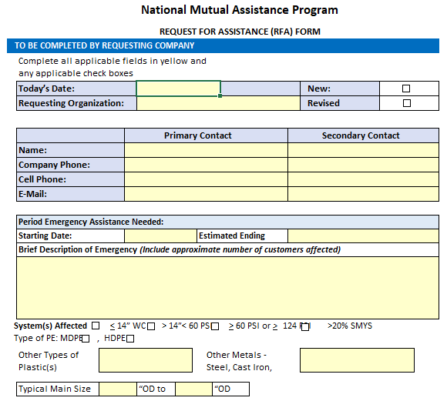
RFA Spreadsheet – Request Form Fields
Fields are easy to fill in. Any yellow cell can be filled in.
Any checkbox can be selected through out the forms.
The Request tab and Response tab are password protected for formatting needs.
Notes:
John

Slide 11
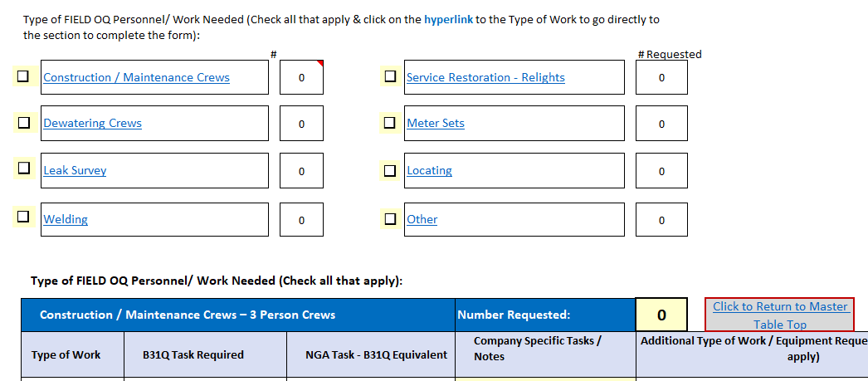
RFA Spreadsheet – Techs / OQ
Requester will check box for disciplines needed and then click hyperlink to that section.
Requester will select all OQ Tasks and any Additional Work/Equip checkboxes within that section.
Will fill in Number Request box of total personnel needed for this discipline.
When completed, click Return to Master Table.
If additional disciplines are needed, repeat the same steps.
Once this is done you will go to section Cell B192 “Type of Other Personnel/Equip”
Notes:
John

Slide 12
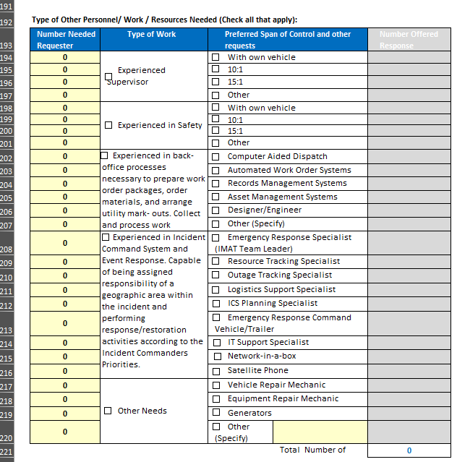
RFA Spreadsheet – Other Types/Equip Logistic Section & Additional Info Section
Requester will enter number of needed in “Number Needed Column.
Check boxes for applicable boxes in Type of Work column
Check all applicable boxes in Preferred Span of Control Column.
Once this is done you will continue to answer the questions in Logistic fields and Additional Information fields to complete the tab.
Once completed, you are ready to solicit other Operators who will fill in the green Response tab.
Notes:
John

Slide 13
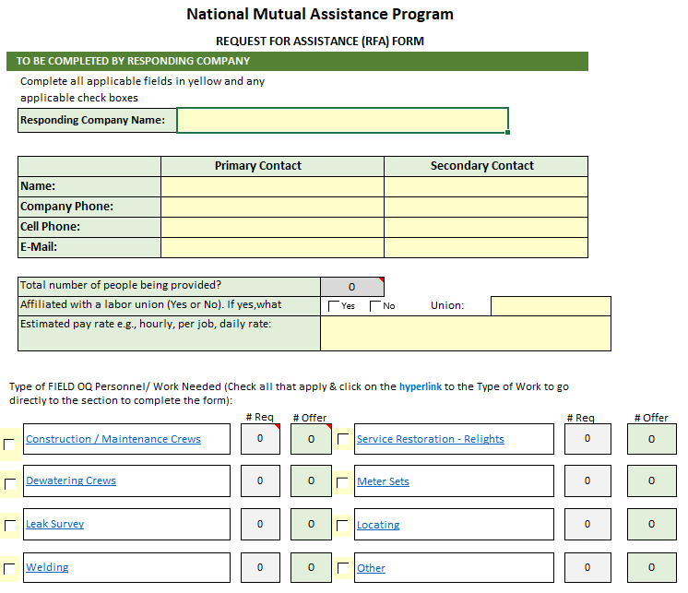
RFA Spreadsheet – Response Form Fields
Fields are easy to fill in. Any yellow cell can be filled in.
Any checkbox can be selected through out the forms.
The Request tab and Response tab are password protected for formatting needs.
Process is same as Request tab. Values will transfer from Request tab into the Response tab (Grey Fields)
Notes:
John

Slide 14
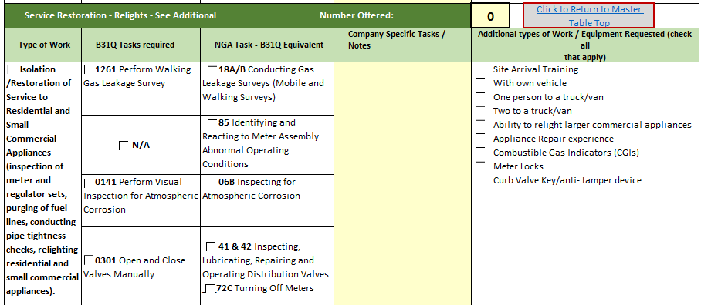
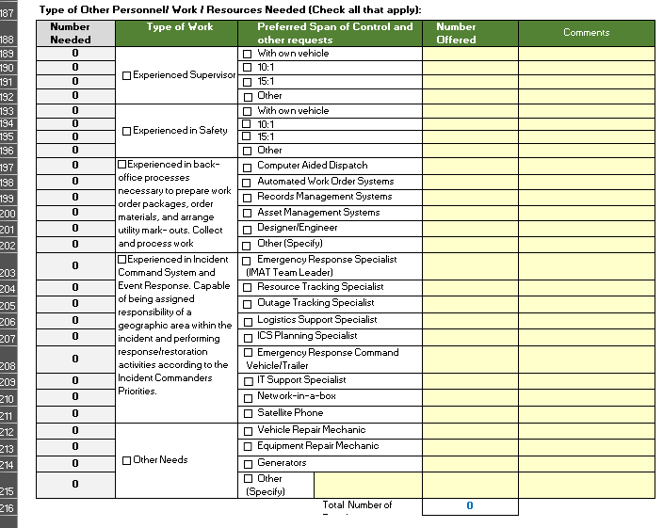
RFA Spreadsheet – Response Form Fields OQ and Additional Information
Fill in all OQ checkboxes. Can compare them in the Request tab.
Enter number in Number Offered box.
Click Return to Master Table to see what is being requested and what you can provide.
Process is same as the Request tab.
Enter the Number Offered values and any comments
Values will transfer from Request tab into the Response tab (Grey Fields)
Continue to enter fields in the Additional Information fields to complete the tab.
Once it is finished and work is checked, you are ready to send it back to the Requesting company.
Notes:
John

Slide 15
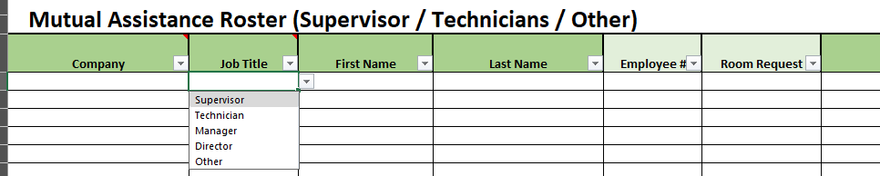
RFA Spreadsheet – Roster List
The intent of this tab is to make it easy for the Requesting company to compile all the names being provided by all of the responding companies (once known) using a standardized format. (Copy and paste) This step may need to wait until confirmed with Requesting company of its needs
Some columns the data fields have drop down selections. Please use them to be able to sort/query later.
If there is dropdown selection that is not applicable, the user can type in a new value into the cell.
Column Names in Dark Green are minimum required fields.
All other columns in light green are optional but would be helpful if known and /or data is readily available
Notes:
John

Slide 16
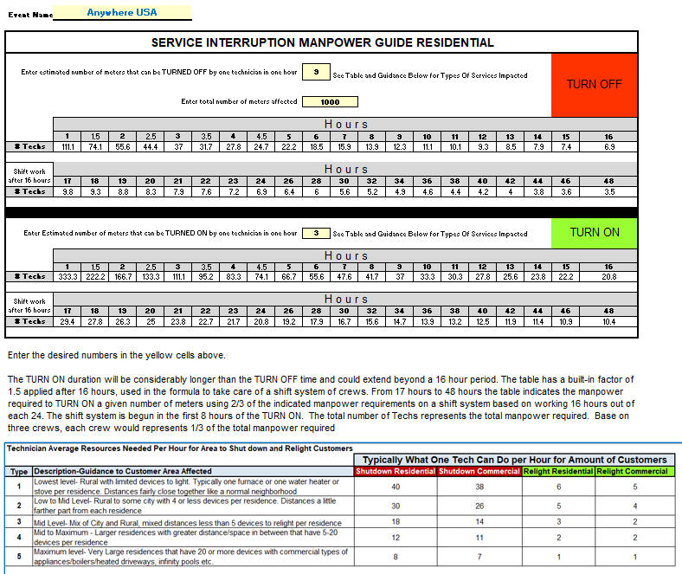
RFA Spreadsheet – Relight Worksheet Tool-Manpower (Only when needed)
This tool can help estimate manpower needed for Shutdown and Relight process when needed.
There is a helpful table at the bottom to help with values as related to types of services
Enter the values in yellow cells and it will calculate the manpower needed for 16-hour shifts.
Notes:
John

Slide 17
Master Compile Spreadsheet
(To be used by Requesting Company)
This Tab the Requesting company will enter all totals for OQ personnel from Responding Companies
This Tab gives guidance on Compile Process and explanation of Tabs
This tab will populate all values and will show all totals for
Needed /Responses
This Tab the Requesting company will enter all totals for Other Personnel/Equipment from Responding companies
This Tab the Requesting Company will enter totals on what was requested
Notes:
John

Slide 18
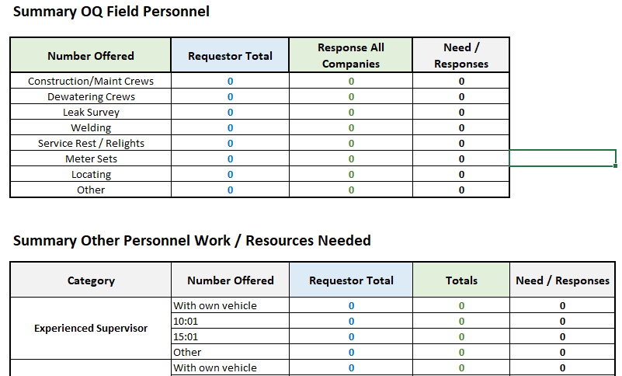
Master Compile Spreadsheet
Once values are known, during the conference call the Requesting operator will discuss what resources will be needed specific to each Responding company and will identify list of personnel to be sent using the Roster List

Slide 19
Next Steps – Future Enhancements
As this is a new process and as it is used in drill/exercises or live events going forward, we would like feedback for improvements/enhancements comments from users. Please contact ? With any comments.
If there are any suggestions to add more helpful tabs in the RFA form, please let us know.
Although this improves the process from the previous one, we are exploring other methods such as an app or an online hosted platform for future enhancements.
Notes:
John

Slide 20


Questions?

